Slide 1


Dockerization Documentation

Slide 2
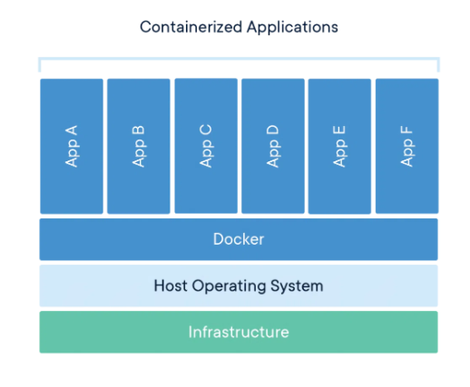
What is Docker?
Docker is a platform for building, running, and managing containerized applications.
Containers are lightweight, standalone, executable packages of software that include everything needed to run an application: code, runtime, system tools, system libraries and settings.
Docker makes it easy to package up an application and its dependencies into a single image that can be run consistently across different environments.

Slide 3
Why use Docker?
Portability: Docker containers can be run on any system that has the Docker Engine installed. This makes it easy to move applications between different environments, such as development, staging, and production.
Isolation: Docker containers are isolated from each other, which means that they cannot interfere with each other. This makes it easy to run multiple applications on the same system without worrying about conflicts.
Reproducibility: Docker containers are always built from the same image, which means that they are always reproducible. This makes it easy to deploy applications consistently across different environments.
Resource efficiency: Docker containers share the host machine's kernel, which means that they are more resource-efficient than traditional virtual machines.

Slide 4
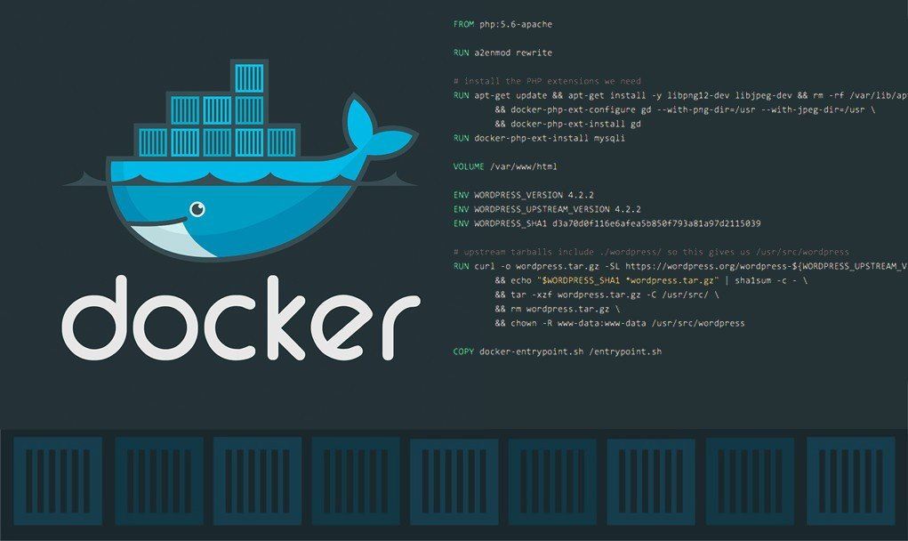
How does Docker work?
Docker images are built from Dockerfiles.
Dockerfiles are text files that contain instructions for building a Docker image.
Docker images are stored in a registry.
Docker registries are central repositories where Docker images can be stored and shared.
Docker containers are created from Docker images.
Docker containers are run on Docker hosts.
Docker hosts are machines that have the Docker Engine installed.

Slide 5
Why containers?
Container: A way to package application with all the necessary dependencies and configuration.
1) It is portable (easy to share and move)
2) Makes deployment more easy and efficient.

Slide 6
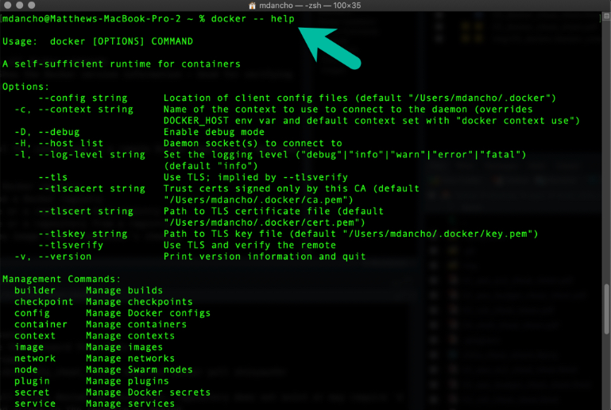
Docker commands

Slide 7
Docker commands
Docker build: Builds a Docker image from a Dockerfile.
Docker run: Runs a Docker container from an image.
Docker pull: Pulls a Docker image from a registry.
Docker push: Pushes a Docker image to a registry.
Docker ps: Lists all running Docker containers.
Docker stop: Stops a running Docker container.
Docker rm: Removes a stopped Docker container.

Slide 8
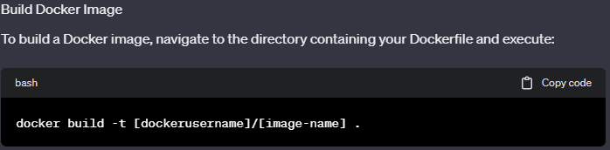
Docker build
To build images in Docker

Slide 9
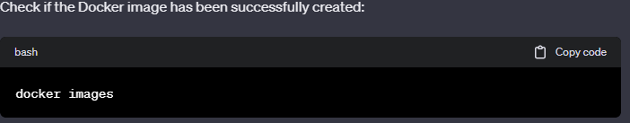
Docker build
To see whether the image is been created

Slide 10
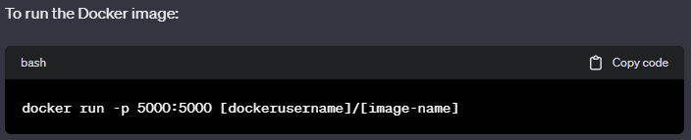
Docker Create
To run the created docker image

Slide 11
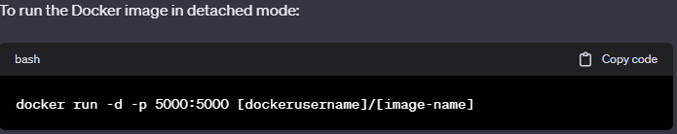
Docker detached
To run the created docker image in detached

Slide 12
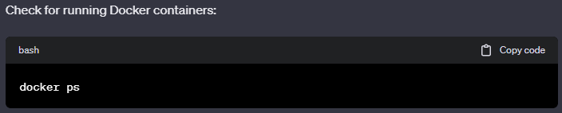
Docker run
To see the running docker image

Slide 13
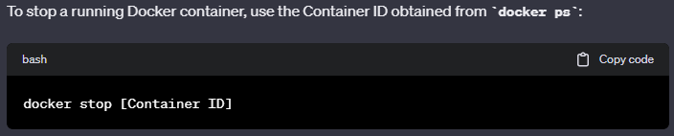
Docker stop
To stop the created docker image

Slide 14
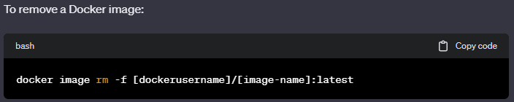
Docker remove
To remove the created docker image

Slide 15
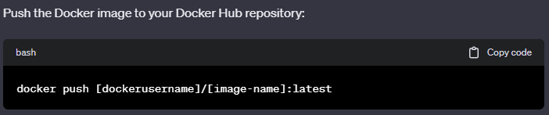
Docker push
To push the created docker image

Slide 16
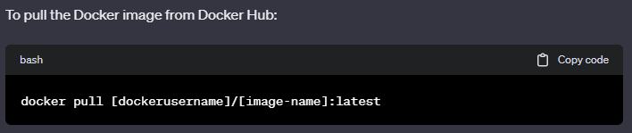
Docker pull
To pull the docker image

Slide 17
Docker Commands in spreadsheet view
https://docs.google.com/spreadsheets/d/1bTuK-ZhOHsL5yU-MIYwtRYeXCEwnle-kgYBXcm5KMyc/edit#gid=1643686534

Slide 18
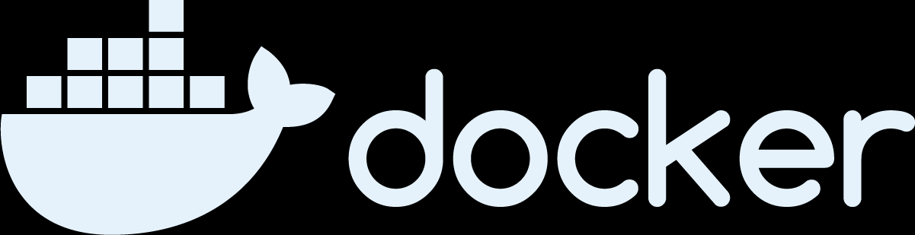
Conclusion
Docker is a powerful platform for building, running, and managing containerized applications. It is a popular choice for developers and DevOps teams who want to build and deploy applications quickly and easily

